Slide 1

BCA Ist Semester Introduction of Logic Circuit and Digital Design(ILCDD) Course Code: BCAC0003
Presented by:
Mr.Anuj Kumar
Assistant Professor, Dept. Of CE&A
GLA University, Mathura

Slide 2
Number Base Conversions
Octal
(Base 8)
Decimal
(Base 10)
Binary
(Base 2)
Hexadecimal
(Base 16)

Slide 3
Decimal to other Base System
Step-1 Divide the decimal number to be converted by the value of the new Base.
Step-2 Get the remainder from Step 1 as the right most digit (LSB) of new base number.
Step-3 Divide the quotient of the previous divide by the new base.
Step-4 Record the remainder from Step 3 as the next digit (to the left) of new base.
Step-5 Repeat Step 3 and Step 4 until the quotient becomes Zero.

Slide 4
Decimal to Binary Conversion
Divide the number by the ‘Base’ (=2)
Take the remainder (either 0 or 1) as a coefficient
Take the quotient and repeat the division
Example: (13)₁₀
Quotient
Remainder
Coefficient
13
/ 2 = 6
1 a₀ = 1
6
/ 2 = 3
0 a₁ = 0
3
/ 2 = 1
1 a₂ = 1
1
/ 2 = 0
1 a₃ = 1
Answer: (13)₁₀ = (a₃ a₂ a₁ a₀)₂ = (1101)₂
MSB LSB

Slide 5
Decimal to Octal Conversion
Example: (264)₁₀
Quotient
Remainder
Coefficient
264
/ 8 = 33
0 a₀ = 0
33
/ 8 = 4
1 a₁ = 1
4
/ 8 = 0
4 a₂ = 4
Answer: (264)₁₀ = (a₂ a₁ a₀)₈ = (410)₈

Slide 6
Decimal to Hexadecimal Conversion
Example: (10234)₁₀
Quotient
Remainder
Coefficient
10234
/ 16 = 639
10 a₀ = 10=A
639
/ 16 = 39
15 a₁ = 15=F
39
/ 16 = 2
7 a₂ = 7
2
/ 16 = 0
2 a₃ = 2
Answer: (10234)₁₀ = (a₃a₂ a₁ a₀)₁₆ = (27FA)₁₆

Slide 7
Other Base to Decimal
Step-1 Determine the positional value of each digit depends on the position of the digit and the base of number system.
Step-2 Multiply the obtained column value by digits in corresponding columns.
Sum the product calculated.

Slide 8
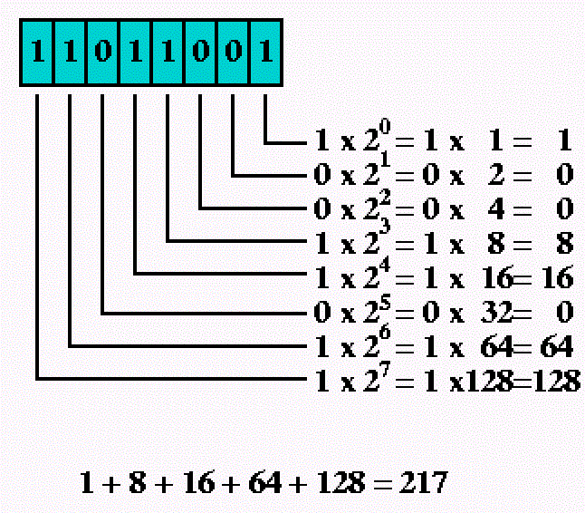
Binary to Decimal Conversion
Multiply the digit with 2(with place value exponent).
Eventually add all the multiplication becomes the Decimal number.

Slide 9
Octal to Decimal Conversion
(345 )₈ =(???)₁₀
(3 * 8²) + (4 * 8¹) + (5 * 8⁰)
=(3 * 64) + (4 * 8) + (5 * 1)
= (229)₁₀

Slide 10
Hexadecimal to Decimal Conversion
(A14B)₁₆ =(???)₁₀
(A*16³)+(1 * 16²) + (4 * 16¹) + (B * 16⁰)
=(4096*10)+(1 * 256) + (4 * 16) + (11 * 1)
= (41291)₁₀

Slide 11
THANK YOU

